Slide 1
CPT: Colorful Prompt Tuning for Pre-Training Vision-Language Models
Yuan Yao , Ao Zhang , Zhengyan Zhang, Zhiyuan Liu, Tat-Seng Chua, Maosong Sun
Reporter: Xiachong Feng

Slide 2
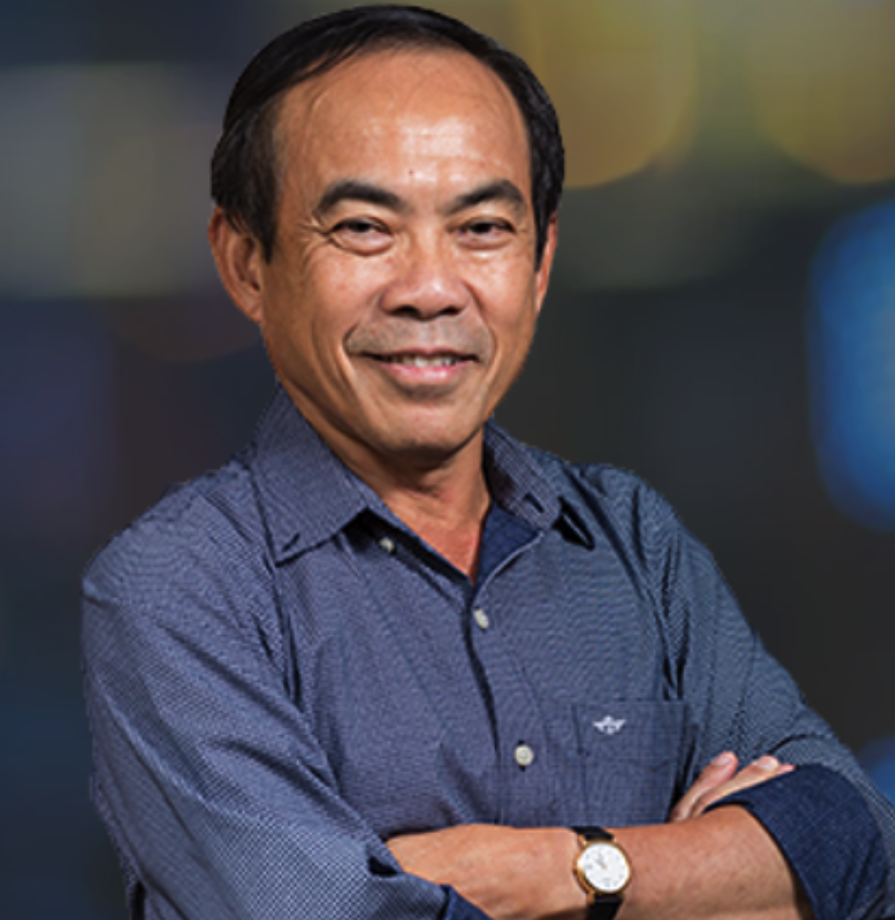
作者介绍
Yuan Yao
THU
Ao Zhang
NUS
Zhengyan Zhang
THU
Zhiyuan Liu
THU
Tat-Seng Chua
NUS
Maosong Sun
THU
Notes:
高天宇： 之前是搞关系抽取的 清华大学刘知远老师组的。现在是普林斯顿大学的博一。主要研究PLM了
Adam Fisch MIT的 quantifying uncertainty and improving robustness in ML models.
Chendanqi 毕业于湖南雅礼中学，国际奥林匹克金奖 免试清华 毕业于yaoban， chris manning的博士 斯坦福 之前搞阅读理解的。

Slide 3
补充： 实验室

Slide 4
题目
From NLP Prompt Tuning to Multi-Modal Prompt Tuning

Slide 5
补充：Prompt Tuning
Pre-train and Fine-tune Paradigm
...
great
terrible
...
CLS head
Label: positive
Label: negative √
MLM head
CLS head
MLM head
Vocab $V$
Label Space $Y$
[CLS] it’s a [MASK] movie in every regard, and [MASK] painful to watch . [SEP]
[CLS] No reason to watch . [SEP]
[CLS] it’s a [MASK] movie in every regard, and [MASK] painful to watch . [SEP]
[CLS] No reason to watch . [SEP]
(a) MLM pre-training
(b) Fine-tuning
Two Gaps

Slide 6
补充：Prompt Tuning
Pre-train and Fine-tune Paradigm
...
Label: positive
Label: negative √
great
terrible
Label: positive
Label: negative √
great
terrible
CLS head
MLM head
CLS head
MLM head
...
Vocab $V$
Label Space $Y$
[CLS] it’s a [MASK] movie in every regard, and [MASK] painful to watch . [SEP]
[CLS] No reason to watch . [SEP]
[CLS] it’s a [MASK] movie in every regard, and [MASK] painful to watch . [SEP]
[CLS] No reason to watch . [SEP]
(a) MLM pre-training
(b) Fine-tuning
Prompt Tuning
(
)
(
)
Label Mapping $M(y)$
[CLS] No reason to watch . It was [MASK] . [SEP]

Slide 7
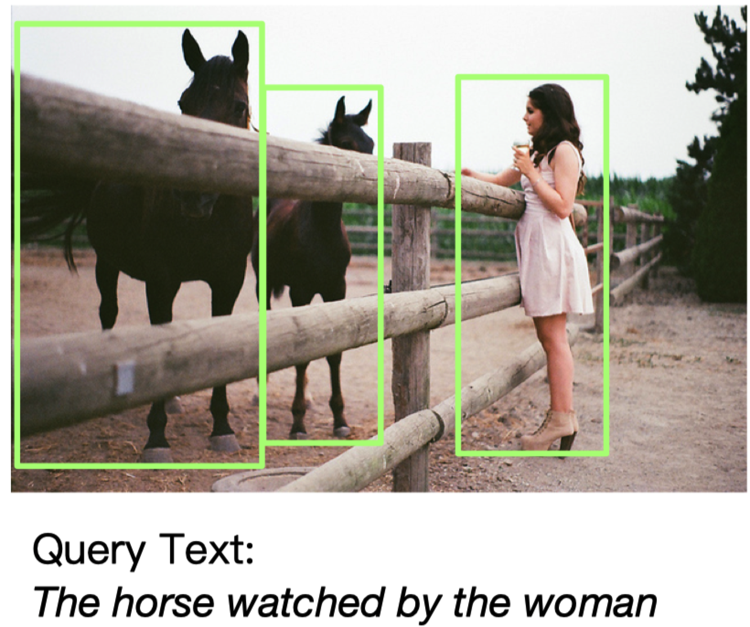
任务
Grounding natural language in ﬁne-grained image regions is essential for a broad variety of vision language tasks, such as robotic navigation (Tellex et al., 2011; Anderson et al., 2018b), visual question answering, visual dialogue, and visual commonsense reasoning.
Given an image $I$ and query text of referring expression $q$, REC aims to locate the target region in$I$that corresponds to $q$.

Slide 8
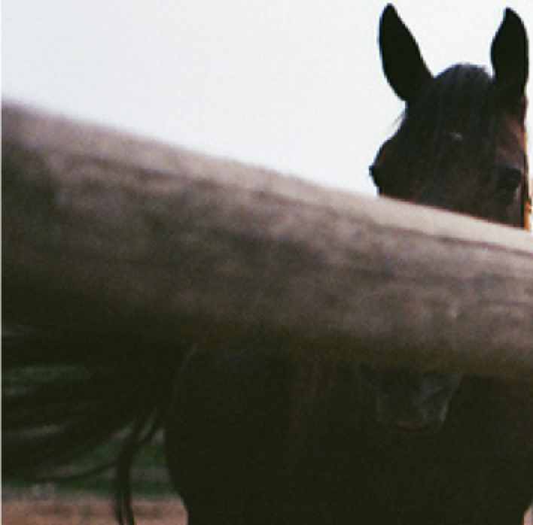
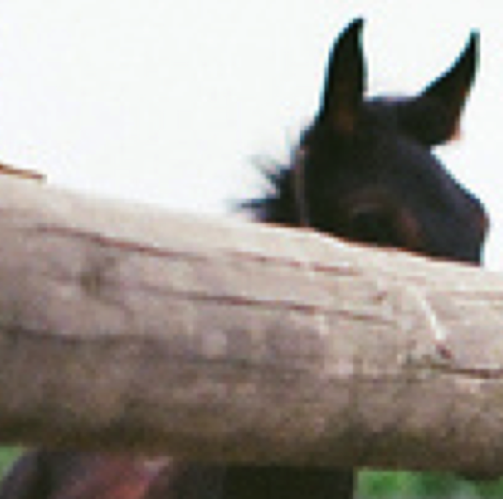
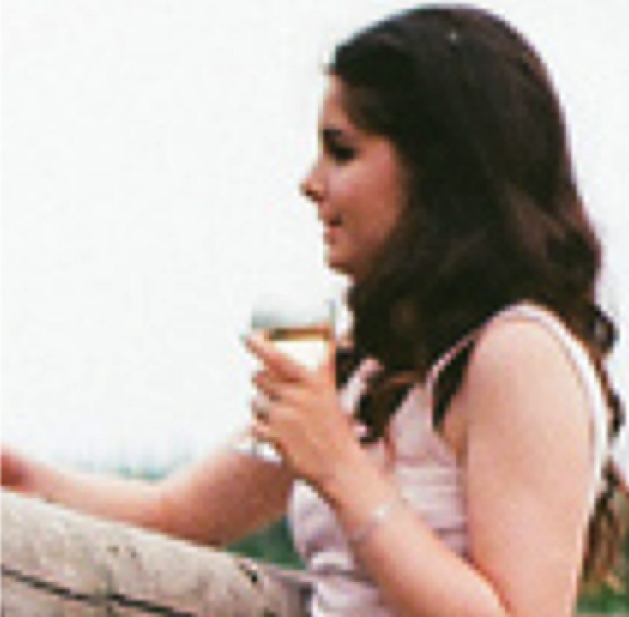
Pre-train and Fine-tune Paradigm
...
watching
riding
...
MLM head
Vocab $V$
[IMG]
...
[CLS]
A
woman
is
[MASK]
the
horse
[SEP]
(a) pre-training
...
Label: positive
Label: negative
...
...
...
CLS head
Label $Y$
[IMG]
...
[CLS]
The
horse
watched
by
the
woman
[SEP]
(b) fine-tuning

Slide 9
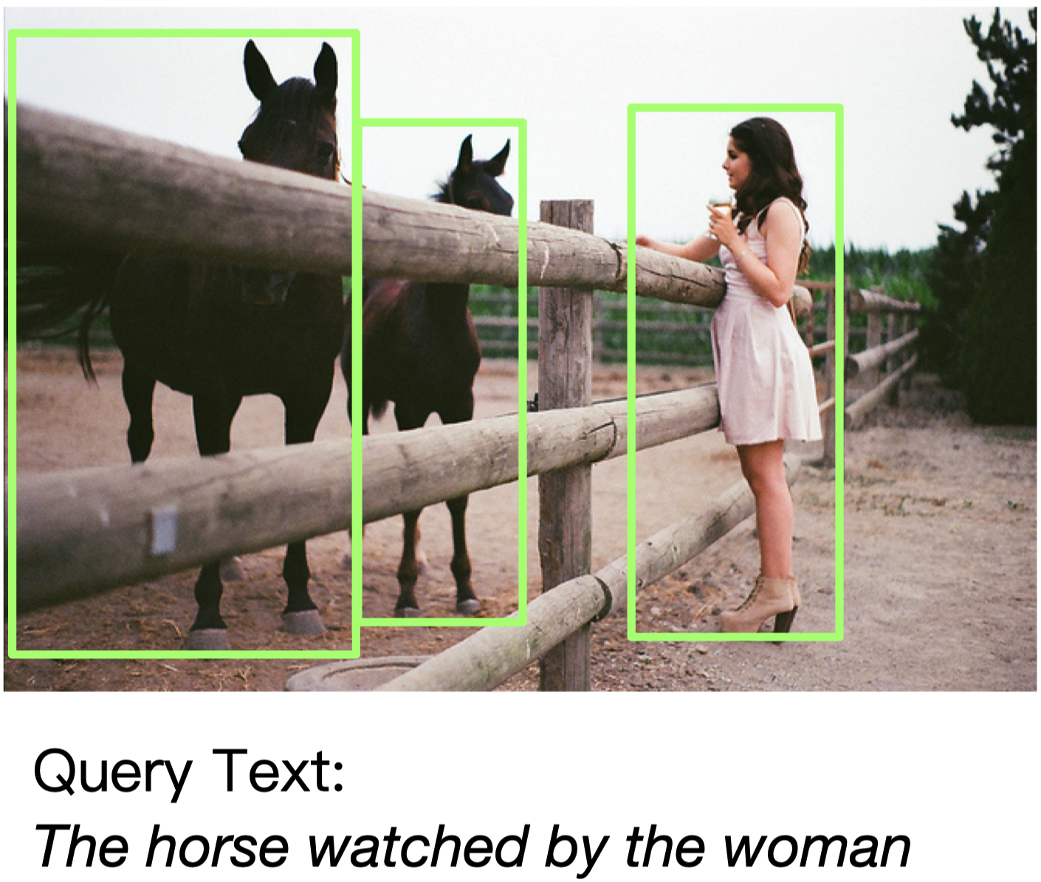
Cross-modal Prompt Tuning
How to distinguish these two horses in the vocab?
...
word1
word2
...
MLM head
Vocab $V$
...
[IMG]
[CLS]
The
horse
watched
by
the
woman
[MASK]
[SEP]
Image Regions
Query Text
Query Template
(c) Cross-modal Prompt Tuning

Slide 10
Cross-modal Prompt Tuning
By color!
Colorful
Prompt
Tuning
...
red
blue
...
MLM head
Vocab $V$
[IMG]
[CLS]
The
horse
watched
by
the
woman
is
in
[MASK]
color
[SEP]
Image Regions
Query Text
Query Template

Slide 11
Prompt
RGB (255, 0, 0)
visual
appearance
red
color text
$$c_{i}=(c_{v}^{i},c_{w}^{i})$$
Visual Sub-prompt
Textual Sub-prompt
[IMG]
[CLS]
The
horse
watched
by
the
woman
is
in
[MASK]
color
[SEP]
Image Regions
Query Text
Query Template

Slide 12
Cross-modal prompt search
Red
MLM head
Score
Red
Blue
Pink
Yellow
......
$$\hat{c_{v1}}$$
(255, 0, 0)
Vocab $V$
$$\hat{c_{v2}}$$
(xx, xx, x)
$$\hat{c_{v3}}$$
(xx, xx, x)
[IMG]
[CLS]
a
photo
in
[MASK]
color
[SEP]
$$\hat{c_{v4}}$$
(xx, xx, x)
......
Color Text $\hat{C_{w}}$
RGB Space $\hat{C_{v}}$
candidate set

Slide 13
实验
(3) CPT slightly underperforms ﬁne-tuning with 16 shots in RefCOCO+ evaluation. The reason is that RefCOCO+ has more color-based expressions (e.g., the person in the red shirt and blue hat), which can disturb our color-based CPT
(4) CPT achieves comparable performance to strong ﬁne-tuned VL-PTMs in fully supervised settings.
(1) CPT outperforms the random baseline and the strong ﬁne-tuning baseline by a large margin in zero-shot and few-shot settings
(2) CPT achieves signiﬁcantly smaller standard deviation than ﬁne-tuning

Slide 14
拓展

Slide 15
总结
Color-based framework as one of the possible prompt tuning solutions

Slide 16
Thanks~

